Slide 1


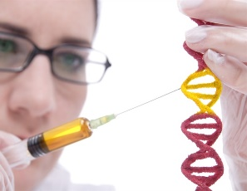

University of Basrah Al-zahraa medical college
Ministry of higher Education and Scientific Research
The module: Molecular, Gene and Diseases
Session 3: Lecture 2
Lecture Title: Regulation of Enzyme Activity
Module staff:
Dr. Wameedh Hashim Alqatrani
Dr. Hamed Jaddoa
Dr. Hazim Talib
Dr. Zainab Ahmad
Dr. Amani Niama
Dr. Zainab Muzahim
Assist. Lect. Amna Shaker
Assist. Lect. Amal Adil
Dr. Hussein K. Abdul-Sada
Dr. Farqad M. Al-Hamdani
Dr. Abeer Leyali Mohammed
Dr. Zainab Khalid
Dr. Douaa Saadi Salim
Assist. Lect. Mohammed Abdullah
Assist. Lect. Ibrahim Ayad
Dr. Inas Ryadh
Dr. Maiada Abdulah
Dr. Ilham Mohamed Jawad
Dr. Ban M. Saleh
Dr. Shant Sunbat
Assist. Lect. Eatidal Akram
Assist. Lect. Taif Ibrahim
This Lecture was loaded in blackboard and you can find the material in:
(Lippincott’s Illustrated Reviews: Cell and Molecular Biology Chapter 5)
For more detailed instructions, any question, or you have a case you
need help in, please post to the group of session

Slide 2

University of Basrah Al-zahraa medical college
Ministry of higher Education and Scientific Research
The Learning Objectives (LO):
At the end of this lecture you should be able to:
List the major regulatory mechanisms that control enzyme activity (plus examples). (LO 3.6)
Discuss the allosteric properties of a key regulatory enzyme such as phosphofructokinase. (LO 3.7)
Discuss the concept of enzyme cascades and the use of protein kinases and phosphatases to regulate activity. (LO 3.8)

Slide 3
University of Basrah Al-zahraa medical college
Ministry of higher Education and Scientific Research
The Learning Objectives (LO):
At the end of this lecture you should be able to:
Define the term zymogen and give examples of enzymes that are derived from zymogens. (LO 3.9)
Explain how activation of the clotting cascade leads to the formation of a fibrin clot. (LO 3.10)
Discuss the mechanisms that are involved in the regulation of clot formation and breakdown. (LO 3.11)

Slide 4
University of Basrah Al-zahraa medical college
Ministry of higher Education and Scientific Research
Role of Enzyme:
Enzymes are central to every biochemical process. They catalyze the hundreds of stepwise reactions that:
Degrade nutrient molecules.
Conserve and transform chemical energy.
Make biological macromolecules from simple precursors.
Through the action of regulatory enzymes, metabolic pathways are highly coordinated.
Regulation of Enzyme action
Substrate and product concentration:
An increase in substrate concentration prompts an increase in reaction rate.
Metabolic enzymes are often inhibited by the end product of the pathway.

Slide 5
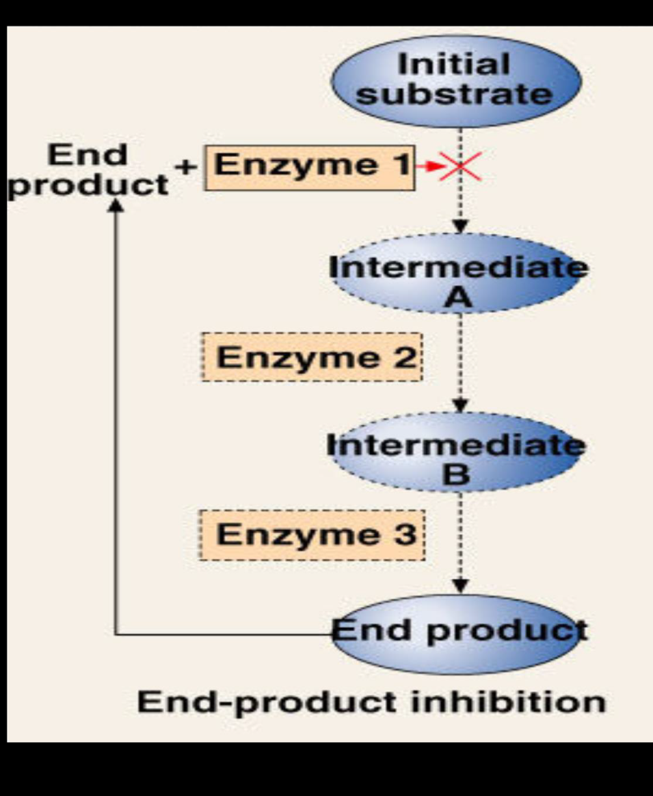
University of Basrah Al-zahraa medical college
Ministry of higher Education and Scientific Research
LO 3.6
Regulation of metabolic pathways
Feedback inhibition: End product of a pathway inhibits by inhibiting enzymes earlier in the pathway. e.g. high [ATP] inhibit catabolic pathways.
Feedforward activation: Increased amounts of initial substrate increases the first step in the pathway. e.g. high concentrations of ethanol induce microsomal ethanol oxidizing enzymes.
Counter regulation of pathways: If a catabolic pathway breaking down compound A is activated then the opposing anabolic pathway making compound A will be inactivated. e.g. glycogenolysis and glycogenesis.

Slide 6
University of Basrah Al-zahraa medical college
Ministry of higher Education and Scientific Research
Regulation of Enzyme action
LO 3.6
2. Changes in the amount of enzyme:
A. Regulation of enzyme synthesis – Rate of enzyme synthesis is usually regulated by increasing or decreasing the rate of transcription of mRNA.
Regulated protein degradation (enzyme turnover) – The amount of an enzyme can be regulated by controlling its rate of degradation.
Proteins can be tagged for destruction by the addition of a small protein molecule known as ubiquitin.

Slide 7
University of Basrah Al-zahraa medical college
Ministry of higher Education and Scientific Research
Regulation of Enzyme action
LO 3.6
3. Changes in enzyme conformation (rapid response time = fraction of seconds).
Allosteric control (regulation)
Covalent modification
Proteolytic activation

Slide 8
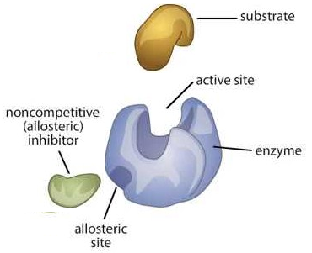
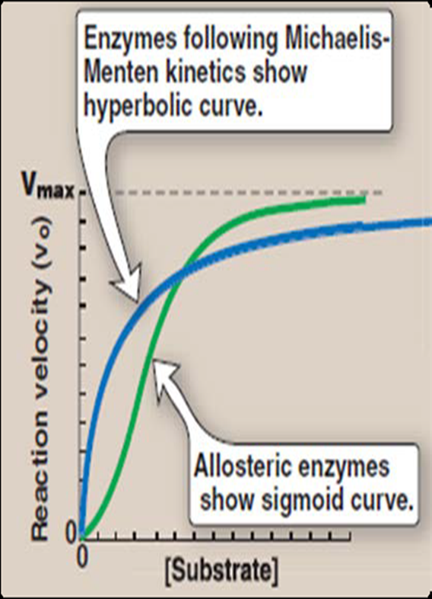
University of Basrah Al-zahraa medical college
Ministry of higher Education and Scientific Research
Allosteric regulation:
LO 3.6
Allosteric enzymes are multi subunit enzymes that contain more than 1 active site for the substrate.
Plots of V vs [S] for these enzymes yield sigmoidal rate curves. This is caused by cooperative.
Other molecules (allosteric modifier) may also bind at sites distinct from the active site to increase or decrease enzyme activity.

Slide 9
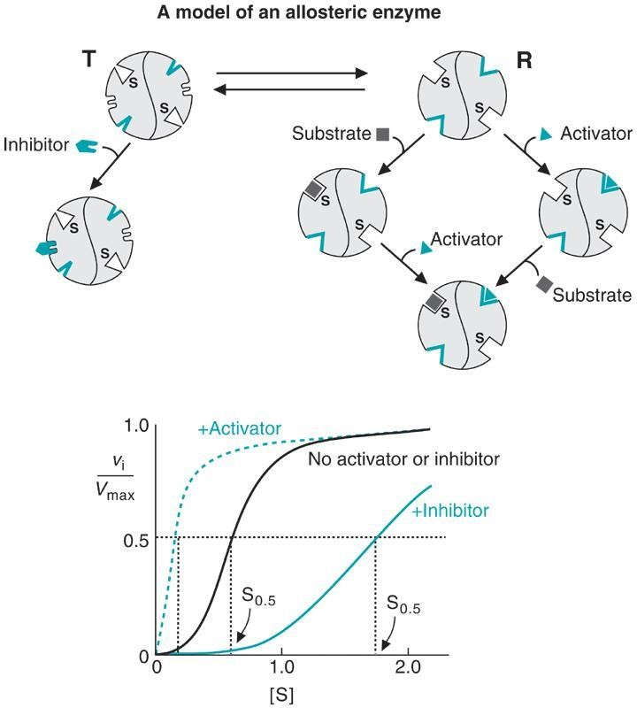
University of Basrah Al-zahraa medical college
Ministry of higher Education and Scientific Research
LO 3.6 & 3.7
Regulation of Enzyme action
Allosteric regulation:
The allosteric site: It is a site for fitting of a small molecule, whose binding alters the affinity of the catalytic site to the substrate. This small molecule is called allosteric modifier.
Stimulatory: (making it more fit) increase activity of enzyme, curve shifted to the left.
Inhibitory: (making the catalytic site unfit) for binding of the substrate.
Decrease activity of enzyme, curve shifted to the right
T= (tense state) R= (relaxed state)

Slide 10
University of Basrah Al-zahraa medical college
Ministry of higher Education and Scientific Research
Regulation of Enzyme action
LO 3.6 & 3.7
Allosteric regulation:
The simplest way of understanding the activity of these allosteric enzymes is to consider that the enzyme exists in two conformational states: a T (tense) state in which the active sites in the enzyme have a low affinity for substrate, and a R (relaxed) state in which the active sites have a high affinity for substrate.
Binding of substrate to one active site somehow alters the conformation of the enzyme, converting the T form into the R form.
Thus the equilibrium between T and R becomes displaced in of the R form.
This simple model can also explain the effects of activators and inhibitors: an allosteric inhibitor binds to the T form and stabilizes it, an activator, on the other hand, binds to the R form and stabilizes it.
Consequently, an allosteric inhibitor shifts the R to T conformational equilibrium toward T, whereas an allosteric activator shifts it toward R.

Slide 11
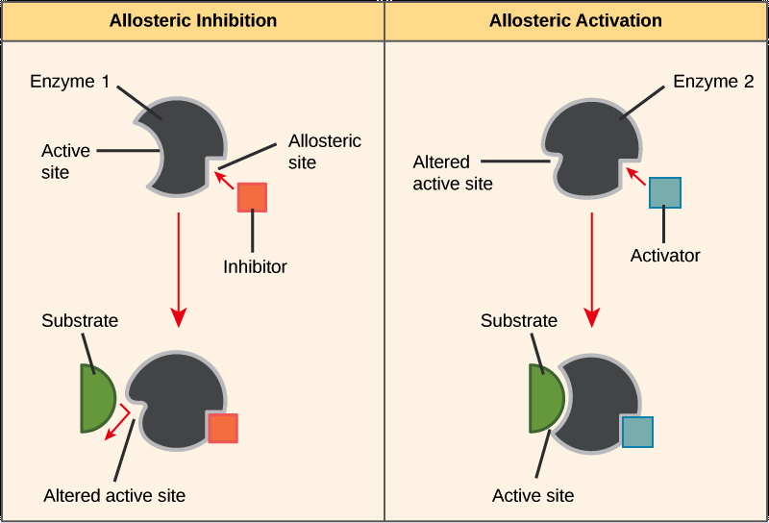
University of Basrah Al-zahraa meAdical college
Ministry of higher Education and Scientific Research
LO 3.6 & 3.7
Regulation of Enzyme action
Allosteric regulation:

Slide 12
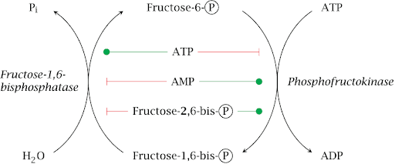
University of Basrah Al-zahraa meAdical college
Ministry of higher Education and Scientific Research
LO 3.6 & 3.7
Regulation of Enzyme action
Allosteric regulation:
Fructose-6-P + ATP -----> Fructose-1,6-bisphosphate + ADP
PFK catalyzes 1st committed step in glycolysis (10 steps total)

Slide 13
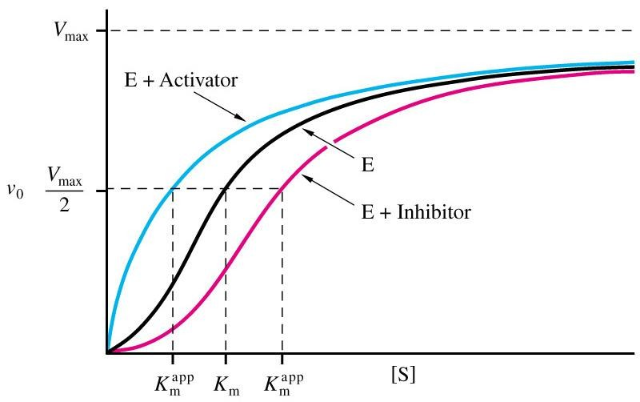
University of Basrah Al-zahraa medical college
Ministry of higher Education and Scientific Research
LO 3.6 & 3.7
Allosteric regulation:
PFK Vo vs [S] plots give sigmoidal curve for at least one substrate
Binding of this allosteric inhibitor or this activator does not effect Vmax, but does alter Km. Allosteric enzyme do not follow M-M kinetics

Slide 14
University of Basrah Al-zahraa medical college
Ministry of higher Education and Scientific Research
Regulation of Enzyme action
LO 3.6 & 3.8
B. Covalent modification (addition or removal of chemical groups):
There are many different types of groups that can be covalently attached to proteins (enzymes) via amino acids, e.g. Phosphoryl, adenyl, acetyl, uridyl, methyl, palmitoyl, myristoyl, ribosyl etc.
The most important type of modification for regulation is phosphorylation.
Phosphate groups are added to ~OH groups of the amino acids serine, threonine or tyrosine.
The introduction of a bulky, charged group can significantly affect enzyme conformation or substrate binding.

Slide 15
University of Basrah Al-zahraa medical college
Ministry of higher Education and Scientific Research
LO 3.6 & 3.8
Regulation of Enzyme action
B. Covalent modification
Regulation by covalent modification is slower than allosteric regulation.
Reversible.
Require one enzyme for activation and one enzyme for inactivation
Covalent modification freezes enzyme T or R conformation.

Slide 16
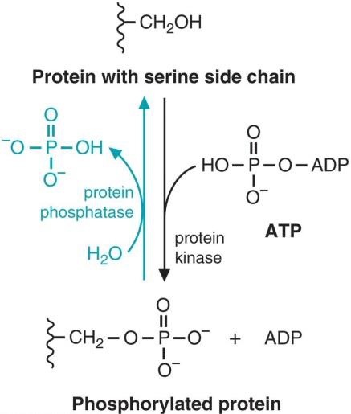
University of Basrah Al-zahraa medical college
Ministry of higher Education and Scientific Research
Regulation of Enzyme action
LO 3.6 & 3.8
B. Covalent modification
Attachment of a phosphate group is catalyzed by a kinase.
Phosphorylation is a reversible process and removal of a phosphate group is catalyzed by a phosphatase.

Slide 17
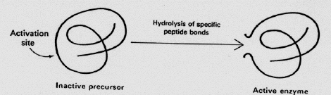
University of Basrah Al-zahraa medical college
Ministry of higher Education and Scientific Research
Regulation of Enzyme action
LO 3.9
C: Proteolytic Regulation
For some enzymes inactive protein precursors, known as zymogens, are activated by the removal of part of the polypeptide chain.
Many proteases enzymes that can break peptide bonds, are produced in this form. This allows the inactive forms to be transported safely to their sites of action without causing premature proteolytic cleavage. e.g. blood clotting factors

Slide 18
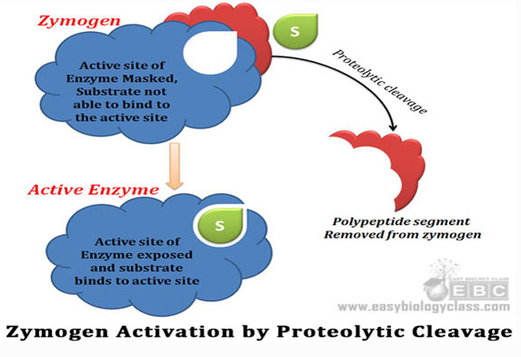
University of Basrah Al-zahraa medical college
Ministry of higher Education and Scientific Research
LO 3.9

Slide 19
University of Basrah Al-zahraa medical college
Ministry of higher Education and Scientific Research
Main mechanisms which regulate the blood clotting cascade:
LO 3.11
Inactive zymogens present at low concentration.
Most tissue factors are present as inactive precursors which are present in the blood at very low concentrations which ensures that clotting is not initiated accidentally.
Amplification of an initial signal.
Damage to blood vessels initiates a cascade of activation resulting in the formation of an insoluble fibrin clot.

Slide 20
University of Basrah Al-zahraa medical college
Ministry of higher Education and Scientific Research
LO 3.11
Main mechanisms which regulate the blood clotting cascade:
Feedback activation by thrombin.
Activated thrombin enhances the conversion of Factors V, VII and XI to activated forms.
Termination of clotting by multiple processes.
Clotting is stopped by removal of the activated proteins, proteolytic digestion and the binding of inhibitor molecules.

Slide 21
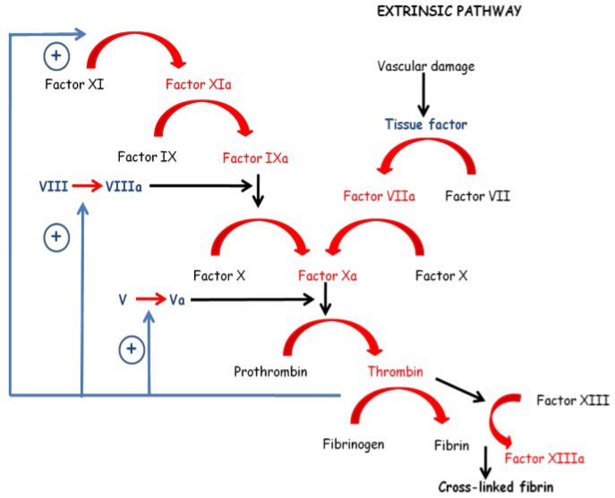
University of Basrah Al-zahraa medical college
Ministry of higher Education and Scientific Research
The blood clotting cascade – an example of a tightly regulated process.
LO 3.1
KEY:
-Inactive zymogens in black.
-Activated enzymes in red.
-Cofactors in blue + feedback activation by thrombin

Slide 22
University of Basrah Al-zahraa medical college
Ministry of higher Education and Scientific Research

